Slide 1
The Strange Physical World of Industrial Ethernet
Mike Nager, METZ CONNECT USA Inc.

Slide 2
What is Industrial Ethernet?
It’s a specific type of “Internet of Things” used to describe Ethernet used on manufacturing plant floors or in process facilities.
It is rapidly growing already. 23% of the 31.3 million industrial networked nodes in 2011 were based on Ethernet. – IMS Research
Total economic value of IoT will be $1.9T by 2020 with manufacturing and health care verticals leading at 15% each. – Gartner Inc.

Slide 3
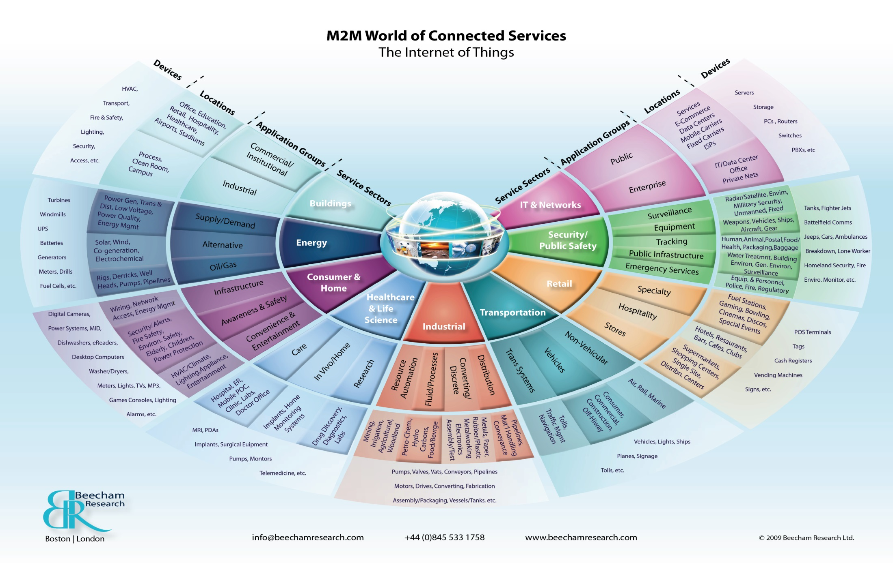
What is Industrial Ethernet

Slide 4
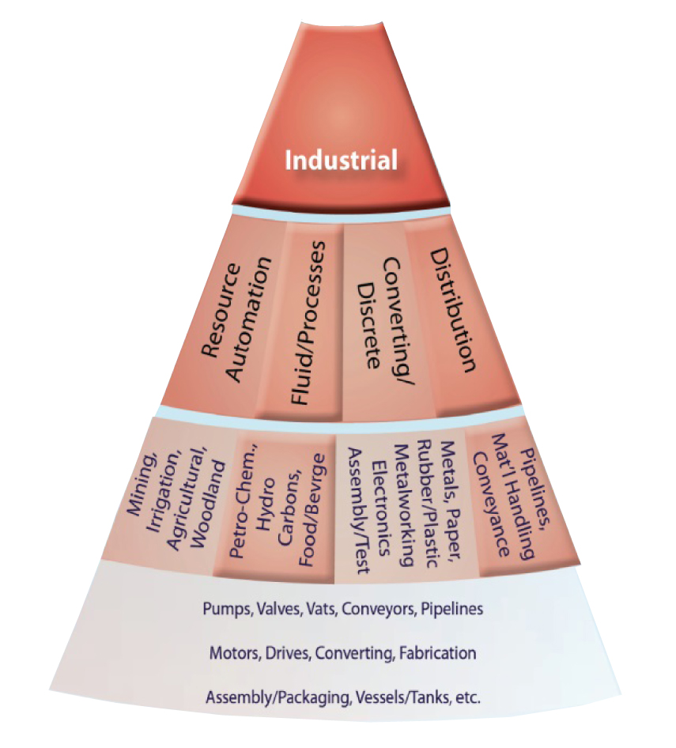
What is Industrial Ethernet

Slide 5

The Internet of Things
Industrial Ethernet Accounts for the Biggest Growth The Internet of Things
Source: Forester Research, CISCO

Slide 6


“Industrial” Looks Different
Ethernet is the biggest thing to hit manufacturing facilities but it’s a lot different then the typical Enterprise network.
According to IMS Research only about 40% of installed industrial Ethernet nodes are standard TCP/IP and seems to be decreasing slightly over time.

Slide 7
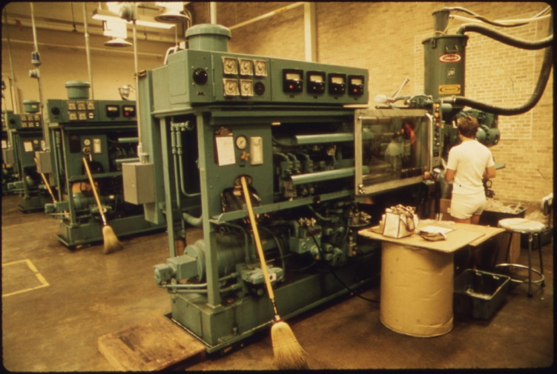
A Look at the Past
Islands of Automation Machines were self contained entities with little communication between each other or the plant facility. Relay logic prevailed.

Slide 8
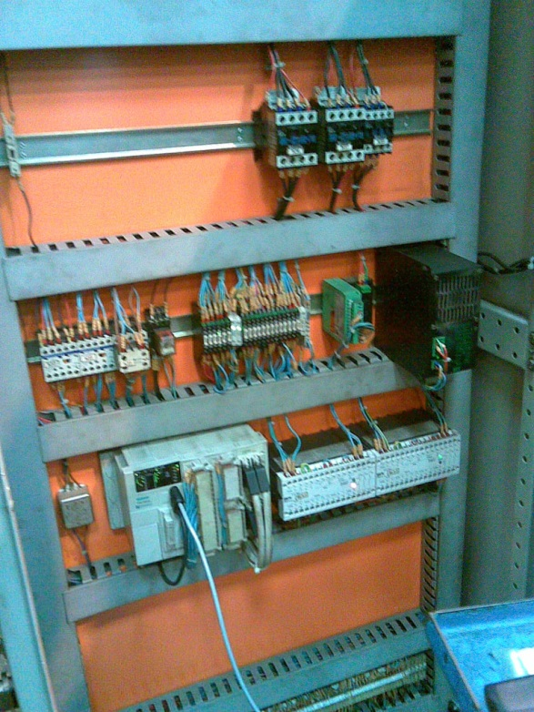
A Look at the Past
Islands of Automation Relays were replaced by PLCs and remained ‘stand-alone’. Some specialized networks started to replace the direct wiring but control and information remained locked to that machine.
http://www.flickr.com/photos/92287895@N00/267323861/in/photolist-pC756-3RpqjT-4b86wT-4bc7HW-4bc7NQ-73JDy1-eoYJAp-fySBbZ-aTkNbV-aTkLQ2-aTkP8P-a3Qx5T-bjcrXK-aTkxyg-aTkeA6-faqaCM-faqaVz-cLL5F3-awSD6D-dzbGD5-b1XcEn-8dkSKQ-bie2Q4-bidUjp-a17jSR-a17iPX-a1abCo-a17jki-a1aaRf-a17jbZ-a1ab2J-a17j8x-a1aaLd-a17jxn-a1abej-a17jAp-9ZNoSk-9ZRf8W-a1ab3J-a1aaFW-ffTdSt-a1ab4Y-a17j2X-a17jRi-a17jrF-a17jEK-a17jqB-a17jHD-a17jmn-a17jS4-a1abib

Slide 9
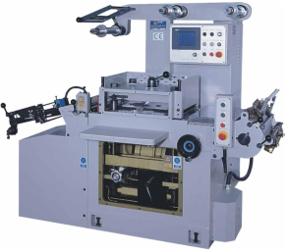

Ethernet to the Rescue
Islands of Automation Ethernet was seen as method of extracting information from the PLC and maybe even its I/O so at least reports could be made.
ETHERNET
GW
GW
GW
GW
Discrete
Control
DeviceNet
Profibus
SERCOS

Slide 10
Progression
But Why Not All the Way?
If machines were connected via Ethernet, why couldn't they be CONTROLLED by Ethernet? Little by little, the objections were overcome.
Ethernet isn’t Fast Enough – We need ‘Real Time Controls’
Ethernet isn’t Deterministic – We can’t have jitter
Ethernet Topography isn’t suitable – Star won’t work
Ethernet isn’t redundant – Can’t have single Source of failure
Ethernet Components aren’t designed for industry – this presentation!

Slide 11
Progression
But Why Not All the Way?
If machines were connected via Ethernet, why couldn't they be CONTROLLED by a variant Ethernet
ETHERNET
Ethernet/IP
Profinet
Ethercat
SERCOS/IP

Slide 12
Seemless Infrastructure
Building Network
Transparent Communication
over all business levels without
Interfaces and communication losses
Data Center
ERP
use of common IT processes for
operation and observation
via web technology
MES
Supervisor
Industrial Ethernet
Web server on PLCs
and machines, remote
maintenance and teleservice directly from the network
Machine
DCS/ PLCs / IPCs
Easy installation
and operation with
convergent using
Device
Sensors/Actors

Slide 13
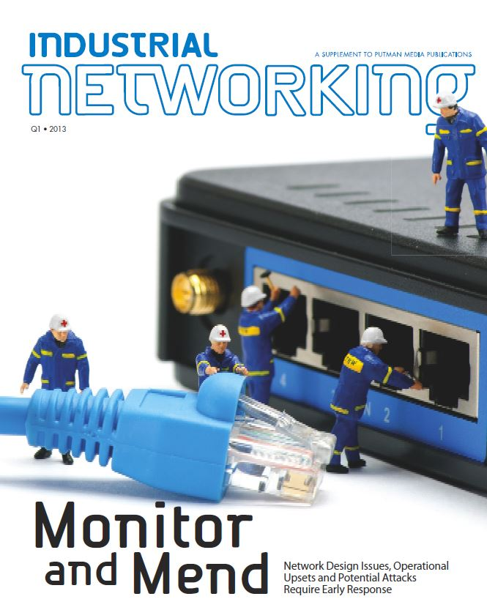

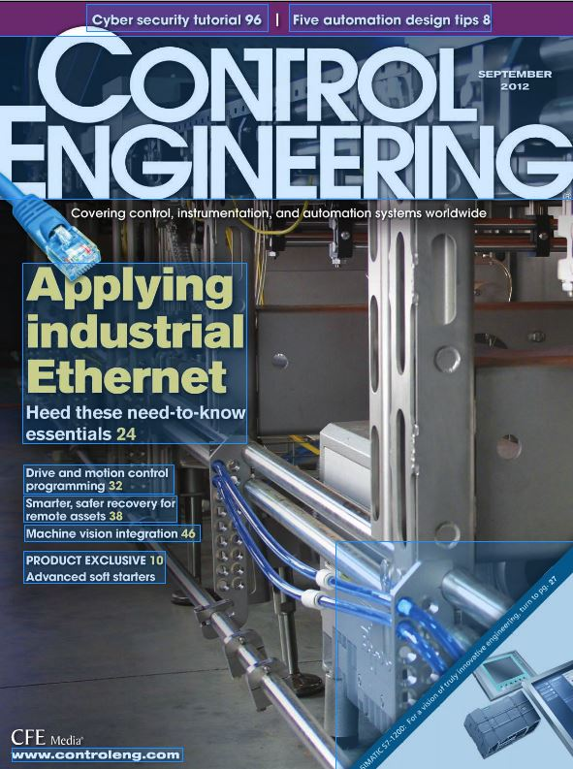

The Buzz Now
Trade Publication Industrial Ethernet is discussed ALL THE TIME

Slide 14
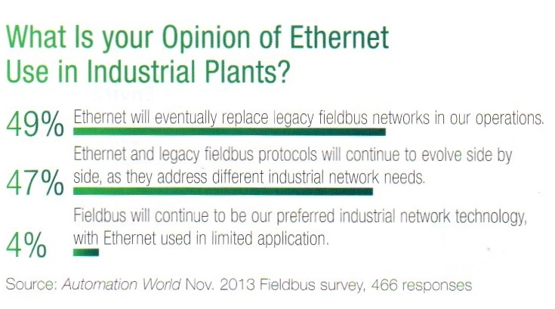
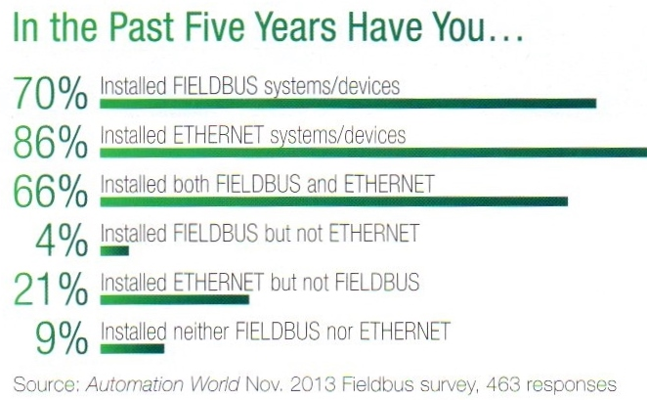
Outlook
Outlook of Industrial Ethernet Recent poll from Automation World

Slide 15
You Aren’t in Kansas Anymore
Users familiar with NEMA / IP ratings and rather than MICE. (Mostly Mice 2 and 3 areas)
DIN rail mounted devices not 19” Racks
Supply voltage is 24VDC not -48V
Classified hazardous areas exist (Division 1 and 2)
No Plenum/Riser Cables – Oil Resistant or High Flex

Slide 16
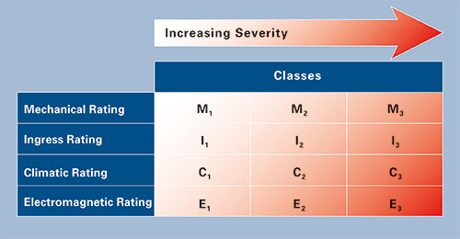
IP Environmental Ratings

Slide 17
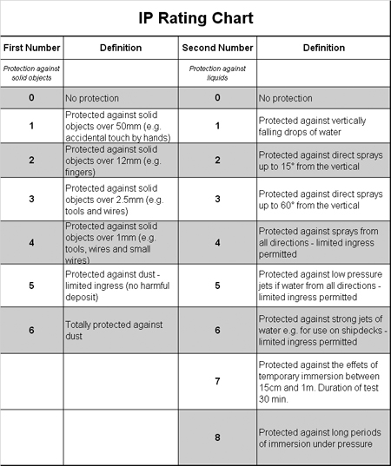
IP Environmental Ratings
IP20 for components inside control cabinets
IP65/67 for components outside control cabinets

Slide 18
General “Industrial” Requirements
Industrial locations include the manufacturing floor, process plant, traffic control, water treatment, and transit systems needing:
“Real Time” Control Needs
Multiple levels of redundancy
More extreme vibration and shock
Water, Dust, Coolant Exposure

Slide 19
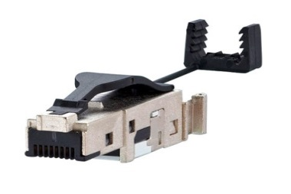
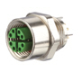
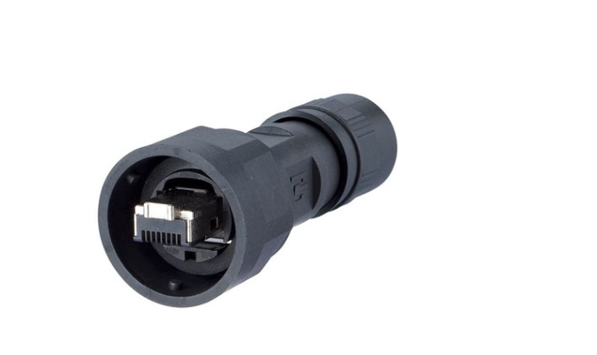
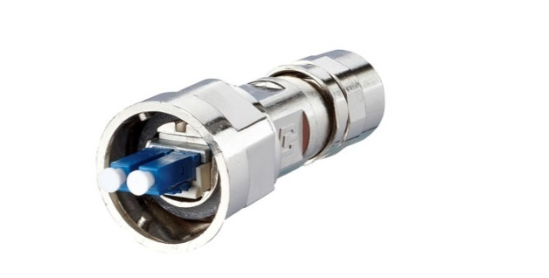
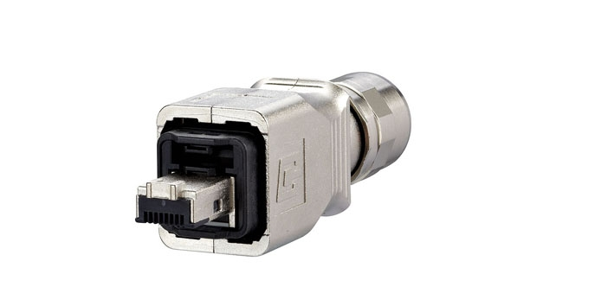
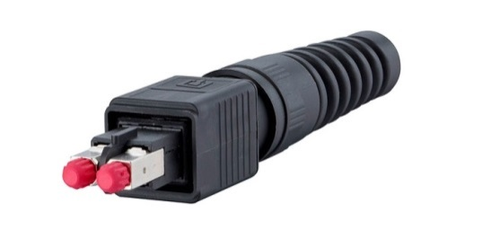
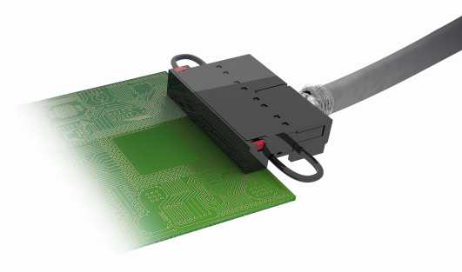
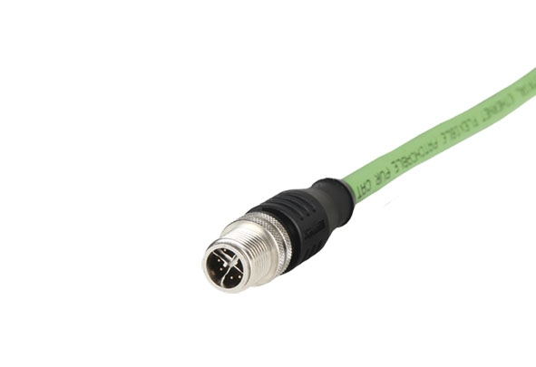
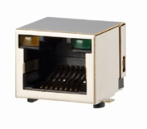
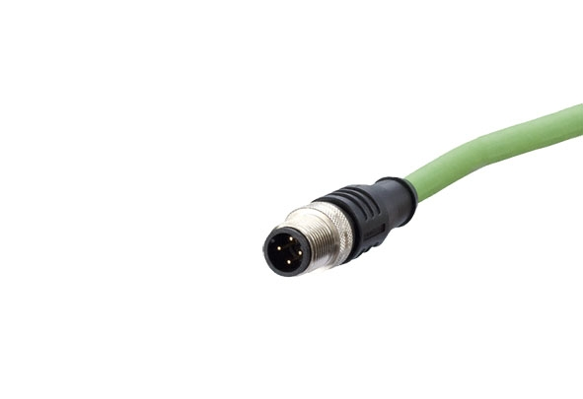
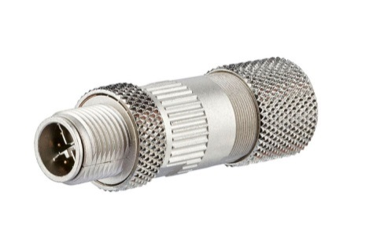
Industrial Device Connections
M12 LP-socket X-coded IP67
Industry field plug Cu IP20
Industry V1 plug
Internet of Things
Industry V1 plug
Industry V14 plug
Industry V4 plug
Gigabit- terminal block IP20
M12 plug X-coded IP67
RJ 45 LP-jack IP20
M12 plug D-coded IP67
M12 X-coded IP67

Slide 20
Industrial Bus Networks
Network | Founder | Organization
Ethernet/IP | Rockwell Automation | ODVA
Profinet | Siemens | PTO
MODBUS-TCP | Schneider Electric | Modbus IDA
Foundation Fieldbus | Fieldbus Foundation | Fieldbus Foundation
SERCOS | Bosch Rextroth | Interest Group Sercos
EtherCAT | Beckhoff Automation | EtherCAT Technology Group

Slide 21
Cable Recommendations
Profinet recommends Shielded Cables
Ethernet/IP prefers unshielded systems
- But Recommends shielding for
Induction welding processes
RF Sources
Electrostatic processes
High current devices (more than 100 amps)
- Uses shields with RC network to prevent DC ground loops

Slide 22
Physical Layer Issues
According to an ISA.org online article, Physical Layer failures accounted for 35% of total failures in plant automation
Two ways to provide reliability is to
Harden the physical layer
Change the network topography

Slide 23
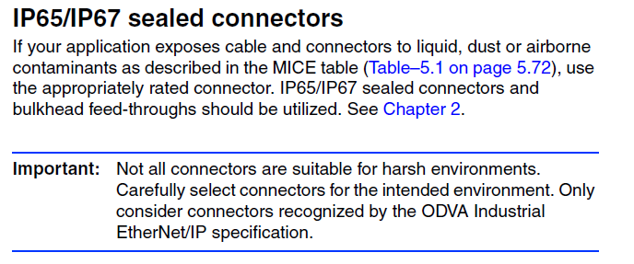
Connector Recommendation
Industrial Control Manufacturers
Guidelines are given by the manufacturers, in this case for EtherNet/IP systems.

Slide 24
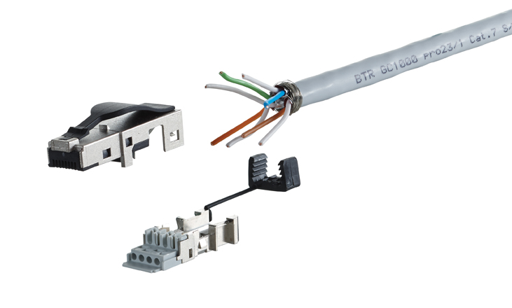
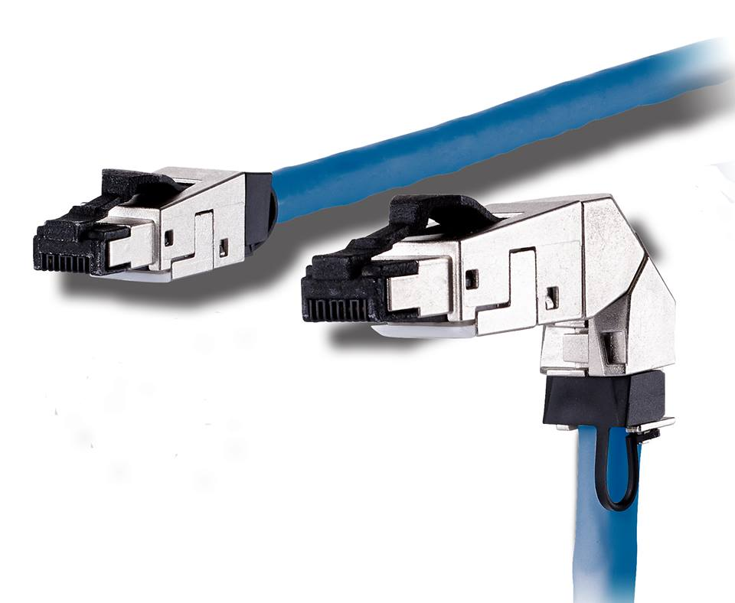
First Step – Harden RJ45
Nylon Locking Tab and Strain Relief
Need to accomodate large individual conductors
Metal Die
Cast Housing

Slide 25
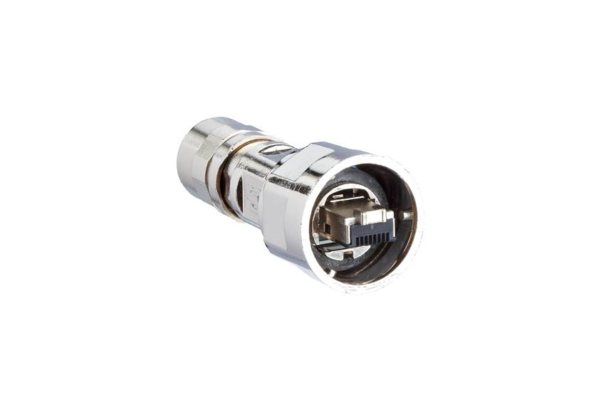
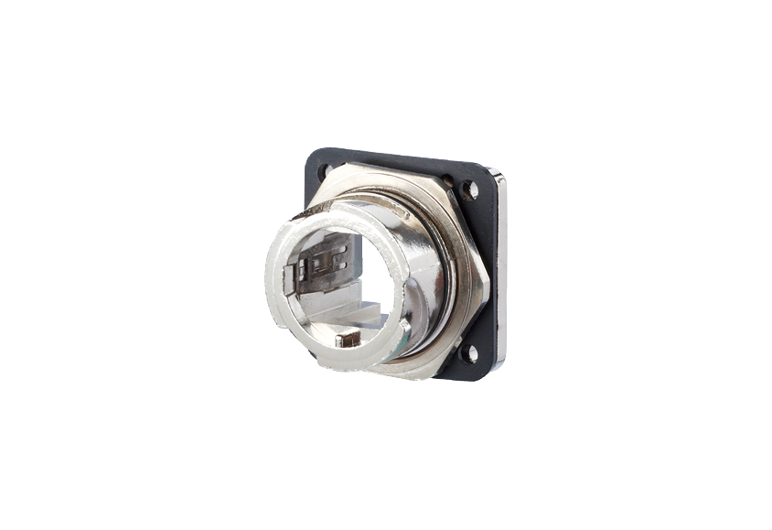
Second Step – Harden Some More
Rugged Construction
Here is a metal version of the “V1” connector system.
Threads and Gaskets for Sealing
Cable Glands and Stress Relief

Slide 26
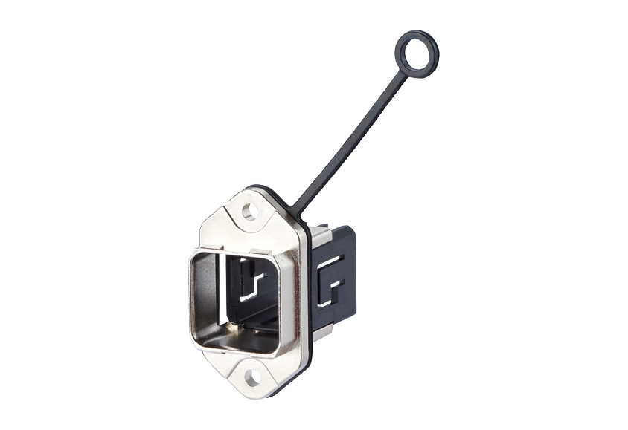
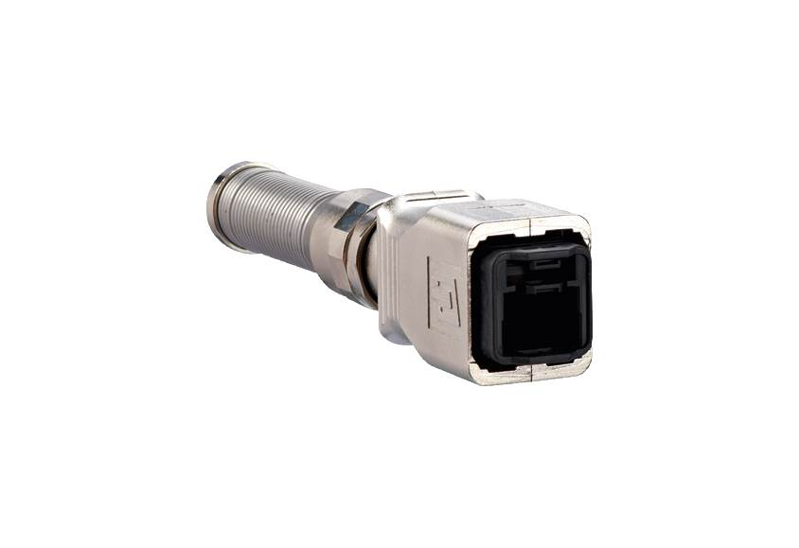
Second Step – Harden Some More
Rugged Construction
Here is a metal version of the “V14” connector system.
Snap on connector

Slide 27
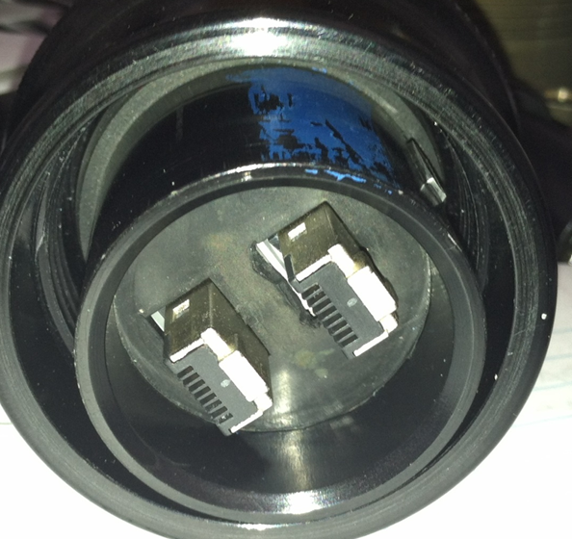
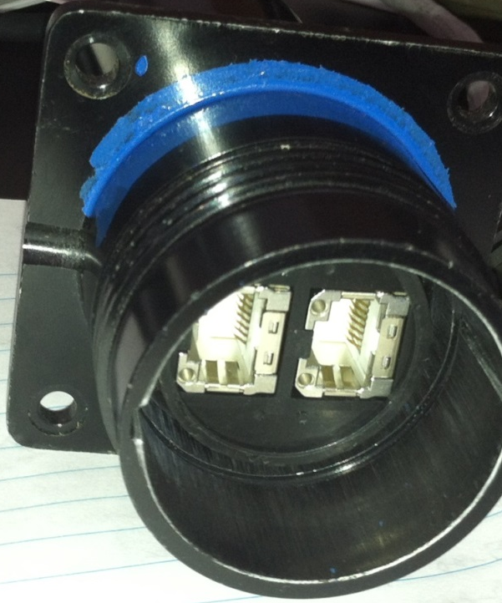
Second Step – Harden Some More
Rugged Construction
A custom built connector that is explosion proof for the Oil and Gas industry.

Slide 28
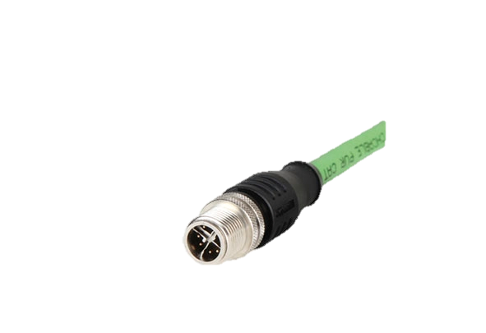
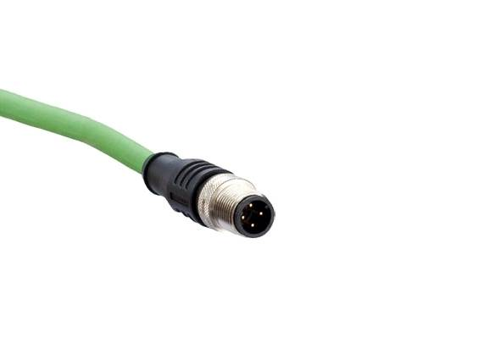
Third Step – Engineer New System
High Band Width Connectors – M12 Footprint
“D” Code for 2 Twisted Pairs
“X” Code for 4 Twisted Pairs

Slide 29
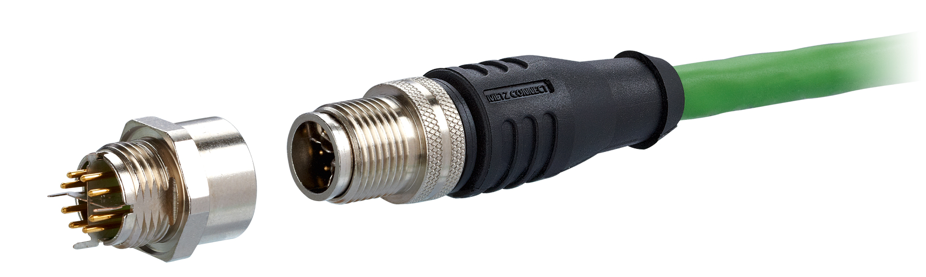
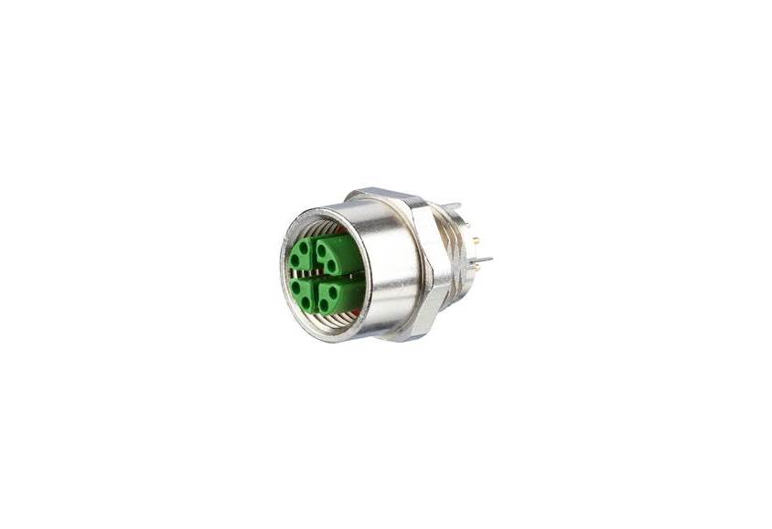
Cutting Edge Standard
X Code M12 for Industrial Gigabit Speeds
Typically PUR or PVC Cable
4 Shielded Pairs in an X shape

Slide 30
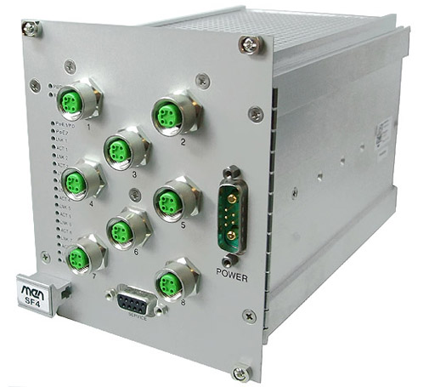
IP67 Ethernet Switch
Electronics Not only connectors need to be rugged.
Metal Housing
M12 Connectors

Slide 31
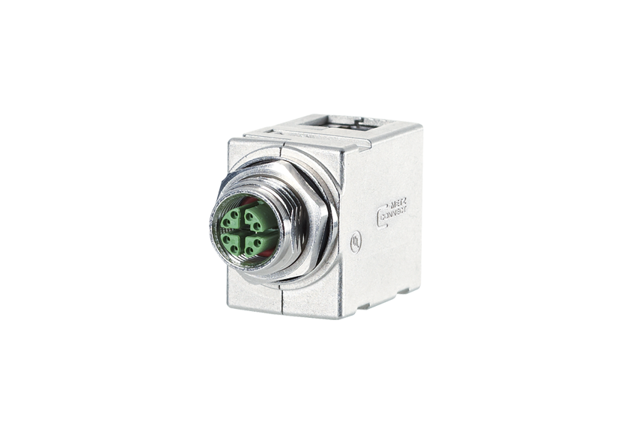
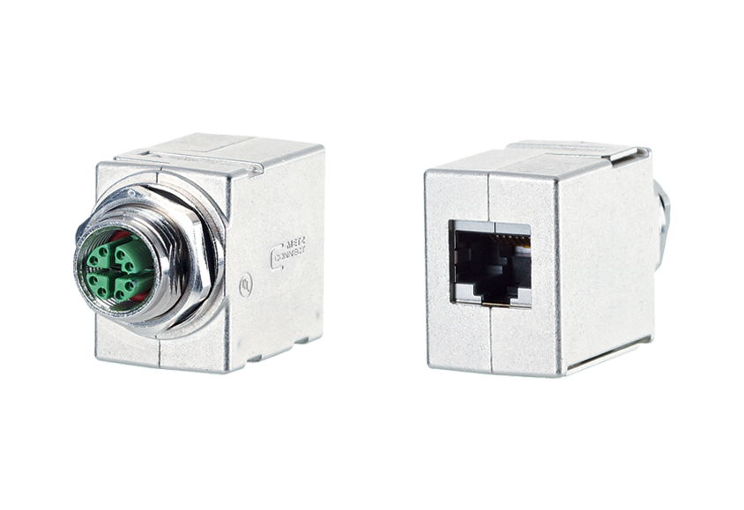
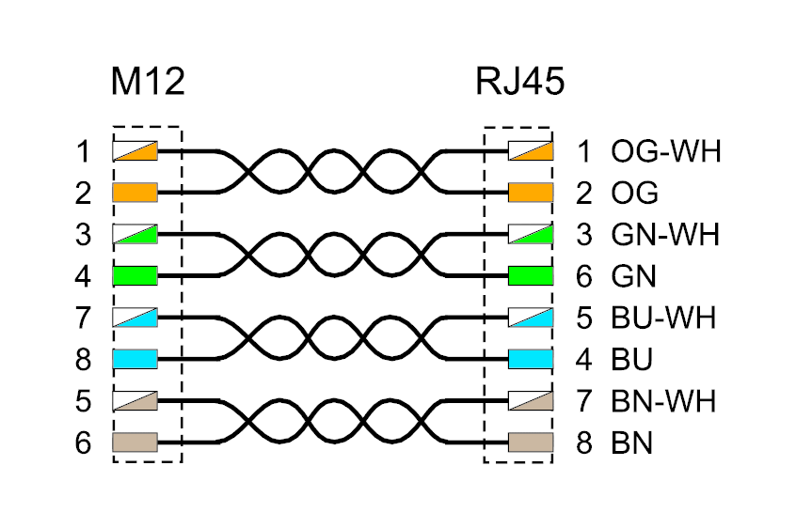
Conversion from RJ45 to M12

Slide 32
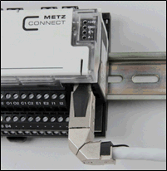
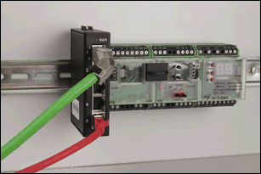
Inside the Cabinet – DIN Rail

Slide 33
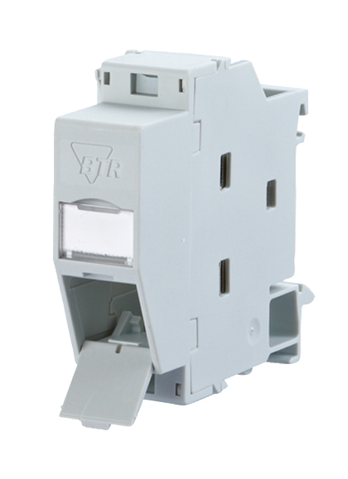
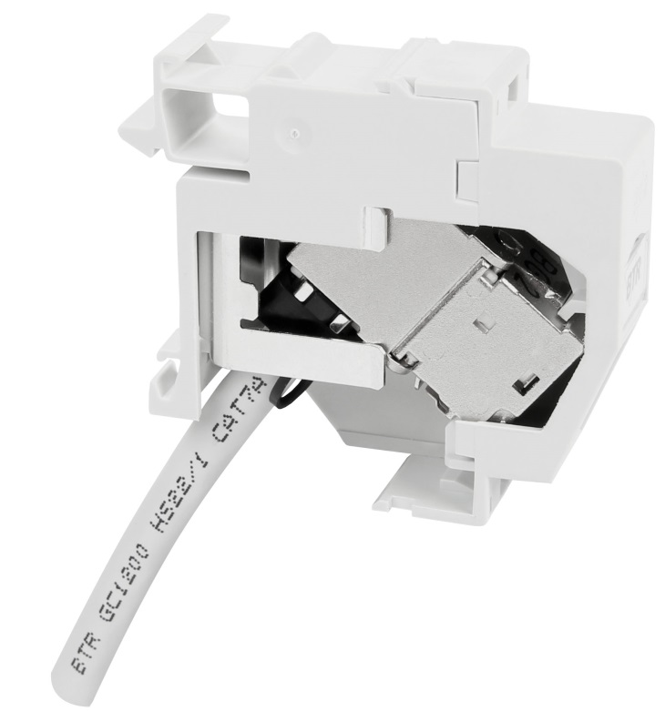
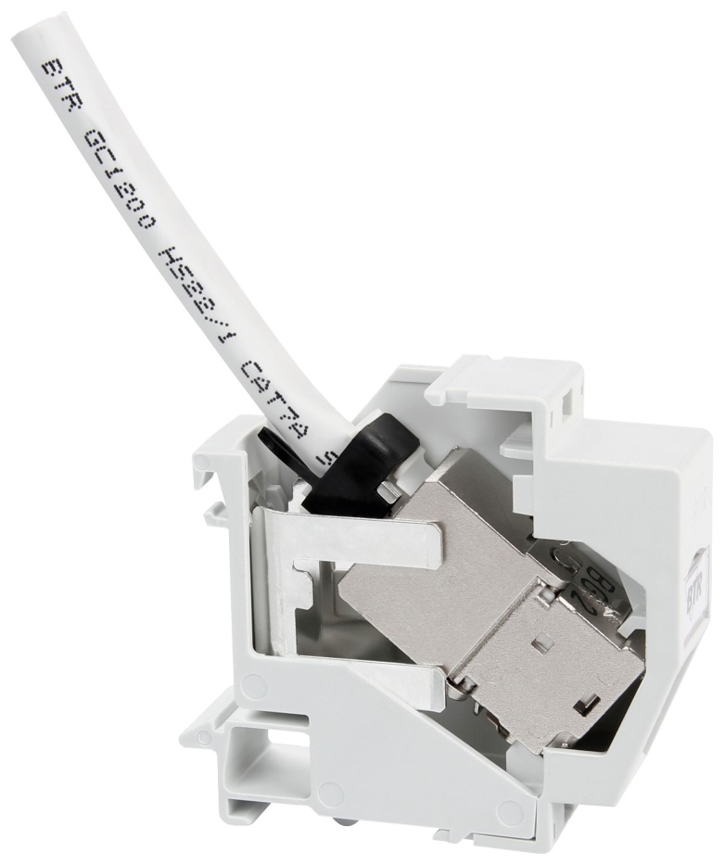
Inside the Cabinet – DIN Rail
RJ45 Jack Meets DIN Rail DIN Rail is the defacto mounting method on the plant floor so devices and connectors are needed in this form factor.

Slide 34
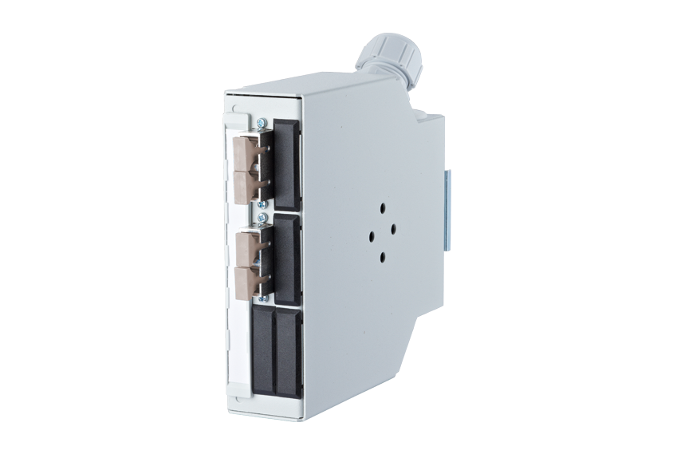
Inside the Cabinet – DIN Rail
Fiber Optic Meets DIN Rail

Slide 35
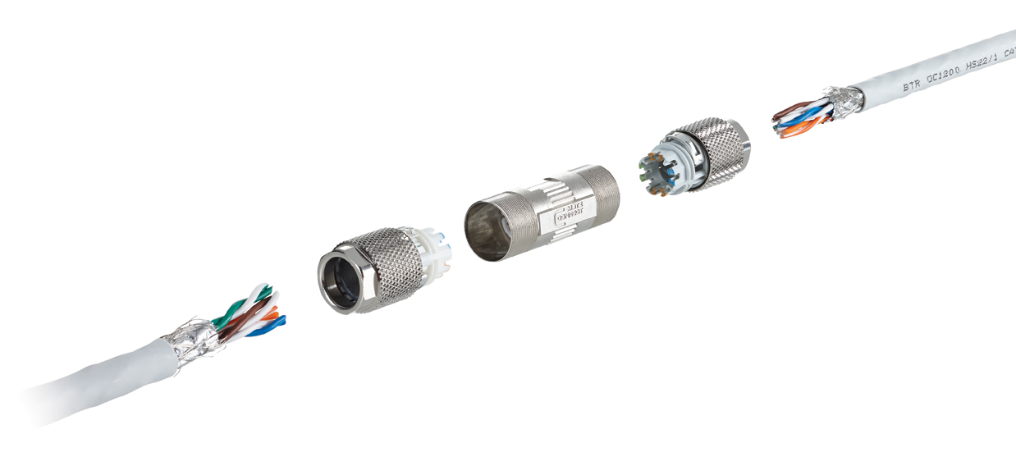
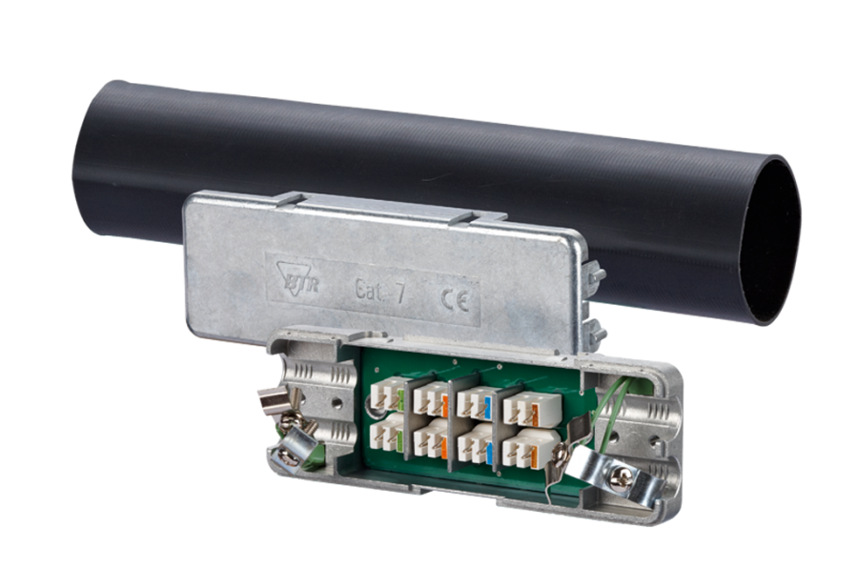
Reliable Extensions and Repairs
Practicality Repairs and Extensions to Ethernet cable need to be done on the plant floor – they will not re-run wires through plants or machines with moving parts unless absolutely necessary. Think of it as a type of consolidation point.

Slide 36
Key Take-Aways
Internet of Things is growing rapidly
Much of it is in the industrial sector – Industrial Ethernet
Environmental considerations are much different than office environments
Physical component failure is the single biggest failure point so the physical layer components have to be well considered

Slide 37

The Strange Physical World of Industrial Ethernet
Mike Nager
Vice President
METZ CONNECT USA Inc.
200 Tornillo Way
Tinton Falls, NJ 07712
Connect with us!

